Slide 1
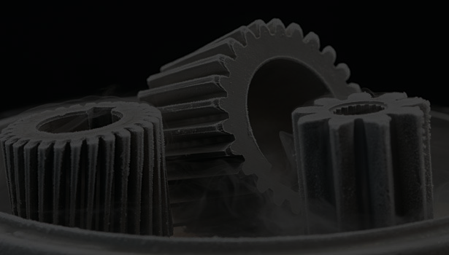
CRYOGENICS CRYOGENIC PROCESSING

Slide 2
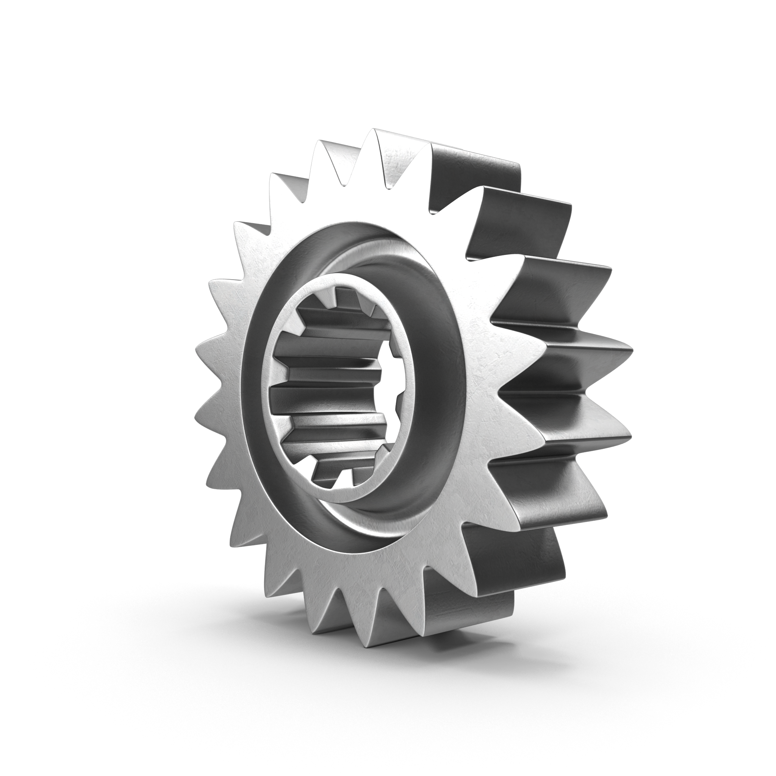
OBJECTIVES
Discuss metallurgic changes
List Cryogenic Processing benefits
Describe Cryogenic Processing
Explain Cryogenics theory and history

Slide 3
CRYOGENICS THEORY
Cryogenic Processing or Deep Cryogenic Treatment (DCT) is the modification of a material or component using cryogenic temperatures
Cryogenic Processing temperatures (below -300ºF/-184ºC) differ from cold treatment temperatures (-140ºF/-96ºC)
Cryogenic Processing offers performance over and above that of cold treatments proven through studies performed by the Illinois Institute of Technology Research Institute for the US Army Aviation and Missile Command

Slide 4
CRYOGENICS THEORY
Cryogenics works on any crystalline metal
Ferrous and non-ferrous metals are comprised of atoms lined up in a crystalline lattice
This lattice is set by the alloys in the metal, the way it is forged, cast, or processed, and how it is subsequently treated
No matter how perfect the production process, there will almost always be flaws in the final material
While not necessarily visible to the naked eye, these flaws create weaknesses and stress points in the material

Slide 5
CRYOGENICS THEORY
The manipulation of this lattice is central to Cryogenics
Atoms make up this lattice and even though they are bound together they are still separated by empty spaces
By lowering the temperature of a crystalline structure, the molecules draw closer together, stabilizing, refining, and collapsing these voids in the grain structure

Slide 6
CRYOGENICS THEORY
By dropping the temperature of materials, sometimes as low as -450ºF/-268ºC, but generally around -310ºF/-190ºC, the structure is forced into even tighter alignment, showing an optimization of the crystalline structure
The freezing and eventual reheating is done in a gradual controlled manner, releasing internal stresses for longer heat and wear life, minimizing susceptibility to corrosion and to micro-cracking caused by shock forces

Slide 7
CRYOGENICS HISTORY
Cryogenics began with cold treatments
There are stories of Swiss watchmakers burying newly made parts in snow, and it is well known that companies would “age” castings by putting them outside during the winter
Indy car builders say their fathers would age castings in a similar manner before using them to make racecar engines
Racer Jim Birks, found engines which sat in junk yards through several winters made superior race engines compared to brand new engine blocks

Slide 8
CRYOGENICS HISTORY
Cryogenics can be traced back to the 1930’s, when the Junkers Company in Germany used it as a vital part of the engineering that went into military airplane components
Chainsaw blades and steel cutting tools were next
Several people began to emerge as driving forces in Cryogenics research in the early 1970’s leading to the development of true cryogenics
They created temperatures that were considerably colder than earth’s temperatures and gained control of the process

Slide 9
CRYOGENICS HISTORY
In the late 1990’s, the American Society for Metals (ASM) International started a committee on Deep Cryogenic Processing after members started to complain about outlandish claims being made such as, “no one has ever blown up a cryogenically treated engine” and “cryogenic treatment increases the strength of steel by ten times”
The committee created a Cryogenics database of research and articles and promoted Cryogenic Processing sessions featured at ASM conferences

Slide 10
CRYOGENICS PROCESSING
Cryogenics Processing is not a coating; it affects the entire volume of the part
Cryogenics Processing does not go away when the part is machined or sharpened; it affects every atom of the structure
Cryogenics Processing is not a substitute for heat-treating; it will not harden parts substantially
Cryogenics Processing is not a fix for bad heat-treating; although it will cause retained austenite to transform to martensite, it will not cure the other ills of bad heat treat

Slide 11
CRYOGENICS PROCESSING
DCT makes changes to the crystalline structure of materials
The major results of these changes are enhanced abrasion resistance and fatigue resistance of the materials
The known changes are transformation of retained austenite to martensite in hardened steels, reduction of residual stress, precipitation of fine carbides in steel, reduction in point defects, redistribution of alloying elements, and making the crystalline lattice more orderly

Slide 12
CRYOGENICS PROCESSING
The change of retained austenite to martensite happens in steel and cast iron only
Despite what many metallurgists think, changing austenite to martensite is not the only thing Cryogenic Processing does
DCT works on materials other than steel
Brake rotors made of cast iron that is pearlitic in structure have no retained austenite, but scientific results show an increase in life of up to seven times

Slide 13
CRYOGENICS PROCESSING
Most metals and some plastics respond to Cryogenic Processing
Metals are crystalline in structure, which means the atoms of the metal line up in a (fairly) orderly fashion
When we reduce the temperature of an object the atoms in the object come closer together producing a more refined crystalline formation in metals and crystalline plastics
Metal objects transmit sound and vibration differently after processing

Slide 14
CRYOGENICS PROCESSING
Cold causes retained austenite to change to martensite
The terms austenite and martensite refer to the way the carbon atoms relate to the ferrous atoms in the crystalline lattice structure
Metals are metals because they are crystalline in nature, not molecular
The crystalline structure is what gives metals their ability to conduct heat and electricity, their ability to plastically deform, and their ability to be hardened

Slide 15
CRYOGENICS PROCESSING
Austenite
Face Centered Carbon Atoms
Martensite
Body Centered Carbon Atoms
Austenite Lattice
Aligned lattice “soft” shell
Martensite Lattice
Misaligned lattice “hard” shell with tough flexible inner core

Slide 16
CRYOGENICS PROCEDURE
The advanced process of DCT uses vacuum insulated chambers called Cryogenic Processors that measure changes in temperature and adjust the input of liquid nitrogen accordingly to ensure that only small fractional changes in temperature occur over a long period of time
A typical DCT cycle runs about three days

Slide 17
CRYOGENICS PROCEDURE
The temperature of an item is reduced slowly to somewhere between -300ºF/-184ºC and -450ºF/-268ºC
Various factors determine the temperature to be reached
The temperature is held there for a while where the metallurgic changes take place
The metallurgic changes become permanent as the temperature gets slowly brought back to room temperature
There may be an above room temperature tempering cycle added

Slide 18
CRYOGENICS BENEFITS
Cryogenics offers a variety of benefits
Deep Cryogenic Treatment results is increased component life that creates many manufacturing efficiency solutions
Deep Cryogenic Treatment results in improvements in mechanical parts and electrical parts
Improvements from Deep Cryogenic Treatment result in considerably longer life of automobile components, and industrial tooling

Slide 19
CRYOGENICS BENEFITS
For instance, valve springs last over six times longer, brake rotors over three times as long, industrial dies and tools over three times as long
DCT can also greatly improve electronics and musical instruments
The process works on most metals, some plastics, carbide, and diamonds
Use of DCT can have a distinct effect on industrial plant efficiency

Slide 20
CRYOGENICS BENEFITS
Cryogenics offers benefits in many varied areas:
Transportation
Marine Environment
Manufacturing
Electronics and Audio Equipment
Sports Equipment
Industry

Slide 21
CRYOGENICS BENEFITS
In Transportation:
Benefits of Deep Cryogenic Processing on automotive components are remarkable and extensive
DCT optimizes the crystalline structure of the engine components, as well as relieves the stresses so that they can withstand higher stresses over a longer period
Many professional race teams cryogenically treat engines, driveline parts and brake rotors because it improves performance and shows increased durability

Slide 22
CRYOGENICS BENEFITS
In Transportation:
Cryogenic Processing multiplies the service life up to five times normal life span
Whether you’re a professional driver, business owner or manager who oversees a large vehicle fleet, or an auto enthusiast interested in saving time, money and resources DCT will benefit your bottom line

Slide 23
CRYOGENICS BENEFITS
In the Marine Environment:
The benefits of Cryogenics don’t only apply on land
Cryogenic Processing profoundly improves boat propellers and engines including final drive components
A cryogenically treated propeller is less prone to warping, fracturing, or shear
The gears and shafts in final drive units last considerably longer

Slide 24
CRYOGENICS BENEFITS
In the Marine Environment:
Cryogenic Processing drastically reduces maintenance costs over the lifespan of all metallurgical parts
Professional boat racers have adapted the technology that race car teams have known about for years
Properly done Cryogenic Processing is the secret weapon that results in faster, more durable boats

Slide 25
CRYOGENICS BENEFITS
In Manufacturing:
If your business depends on a range of industrial machinery like molds, forms, and dies any unanticipated downtime can result in significant losses
Cryogenic Processing improves the quality, durability and lifespan of a range of industrial machine parts that are susceptible to wear due to stress, friction and fatigue
From gears and grinding wheels to hobs and blades, these components can maintain their quality for longer through Deep Cryogenic Processing

Slide 26
CRYOGENICS BENEFITS
In Manufacturing:
Cryogenic Processing reduces downtime on the industrial production and increases the bottom line
NASA is known to cryogenically treat metal before heat treat to reduce the distortion of the metal during heat treat; namely components for the space shuttle’s robotic arm
Gage makers have used cold temperatures to stabilize metals for years

Slide 27
CRYOGENICS BENEFITS
In Electronics and Audio Equipment:
In electronics, vacancies in conducting materials significantly degrade the efficiency of the entire system
They cause signal disruptions that potentially lead to signal discrepancies or outright failure
Deep Cryogenic Treatment realigns the structure of the material resulting in a faster, more reliable transmission

Slide 28
CRYOGENICS BENEFITS
In Sports Equipment:
Deep Cryogenic Treatment is effective in treatment of sports equipment such as golf clubs and metal baseball bats
Laboratory tests on golf clubs conclusively prove that treated clubs hit farther in addition to having improved accuracy
The vibrations in the shaft are reduced, giving more comfort to the user
Aluminum baseball bats hit farther

Slide 29
CRYOGENICS BENEFITS
In Industry, Cryogenic Processing drastically impacts the performance of:
Railcar and railway components
Drilling and logging tools
Wind and hydro electric turbines
Robotic and conducting materials
Conveyor and sawmill parts
Underwater and high-pressure steam pipeline

Slide 30
CONCLUSION
Cryogenic Processing reduces downtime and increases the bottom line
Deep Cryogenic Treatment markedly increases the life span of components and equipment
Deep Cryogenic Processing profoundly improves performance and drastically reduces maintenance costs

Slide 31
CRYOGENICS CRYOGENIC PROCESSING

