Slide 1
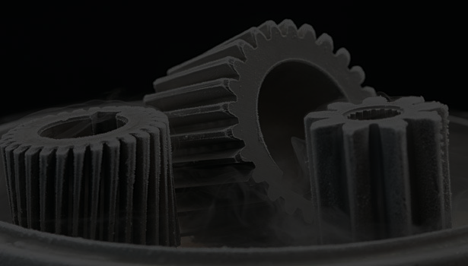
INDUSTRIAL CRYOGENIC PROCESSING

Slide 2
Introduction to Industrial Cryogenic Processing
Deep Cryogenic Treatment or “DCT” and Corrosion Resistance

Slide 3
Cryogenic Processing
The theory and practice of cryogenic processing has been around for decades, almost a century now. The rumour is some old timers who raced cars back in the day, would leave their engine blocks outside for the winter. This was at first a mistake or so they thought, a mistake they learned that somehow the extreme cold of winter makes the block stronger.
German engineers started throwing tools into liquid nitrogen to see the response. As you can imagine it was quite rudimentary but did prove the point that some materials respond very well to extreme colds

Slide 4
Cryogenic Processing
Fast Forward to the space program, NASA Engineers were perplexed when they were analyzing parts of different crafts that had returned from space and realized that the microstructure of the material had changed. At first they thought it was the heat of re entry, but they could
not replicate it under heat. They then went To the opposite side of the scale and
realized it was the extended time in the cold of deep space that caused this change.
Hence our modern term of “DCT” or Deep Cryogenic Processing.

Slide 5
We are constantly looking to improve the corrosion lifetime of materials. It is an important characteristic that is required for the development of material products for usage in non-traditional corrosion environments and specialized applications such as the oil and gas industry.
Cryogenic Treatment is a way to help reduce corrosion, protect your assets and save you MONEY.
Yes, the bottom line is that the ROI on Cryogenic Processing of high value assets is seen through improved material performance and the enhancement of longevity and wear resistance.

Slide 6
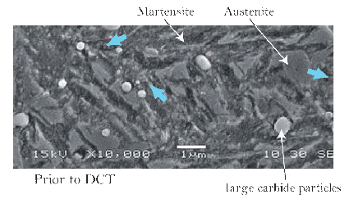
Eta-carbide forming
Prior to DCT
The mechanism that cryogenic treatment contributes to wear resistance is through the precipitation of fine N carbides, which enhances strength and toughness of the martensite matrix.

Slide 7
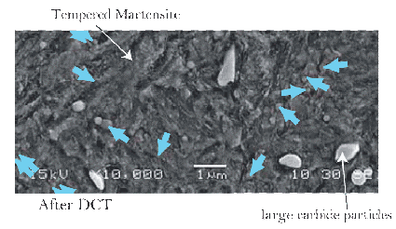
Eta-carbide forming
After DCT
Due to these fine particles or fillers a more compact, more coherent and stronger matrix is formed with the large carbide particles that are already present in the material.

Slide 8
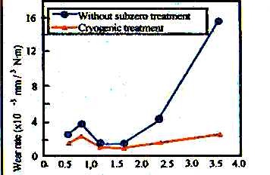
Wear Resistance

Slide 9
Wear Resistance
Wear rate vs. sliding speed for specimens both with and without cryogenic treatment. Austenitization at 1293 K and tempering at 453 K for 1.8 ks. Sliding distance is 200m.
The cryogenic treatment results show 10% to 800% improvements. The wear rate shows a minimum at the sliding speed of 1.14 and 1.63m/s for specimens without and with cryogenic treatment, respectively.

Slide 10
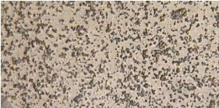
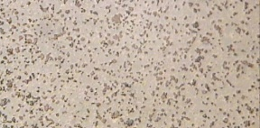
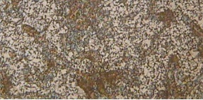
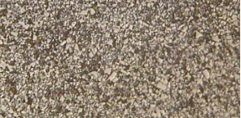
Tungsten Carbide
(a) Untreated eta phase (b) Cryogenically treated eta phase
(c) Untreated gamma phase (d) Cryogenically treated gamma phase

Slide 11
Cryogenics Study
Analysis of the microstructure of cemented tungsten carbide shows that cryogenic treatment significantly alters the microstructure of tungsten carbide, causing the β-phase particles to increase in size and quantity, while the η-phase and γ-phase show a corresponding decrease. The increase in the amount of the binder phase is also supported by evidence of the decrease in thermal conductivity of the cryogenically treated tool as compared to the untreated tool.

Slide 12
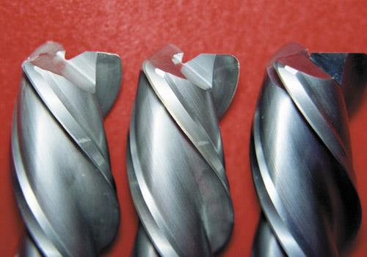
DCT and Cutting Tools
The untreated cutting tool on the left shows wear after 220 hours. The tool in the center was cryogenically treated and after 530 hours in operation is still usable. The tool on the right is a new tool.

Slide 13
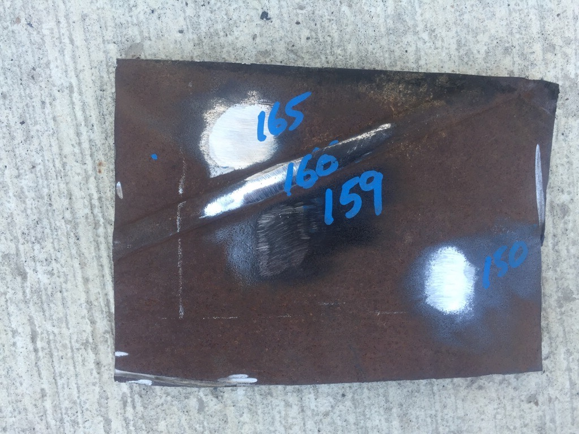
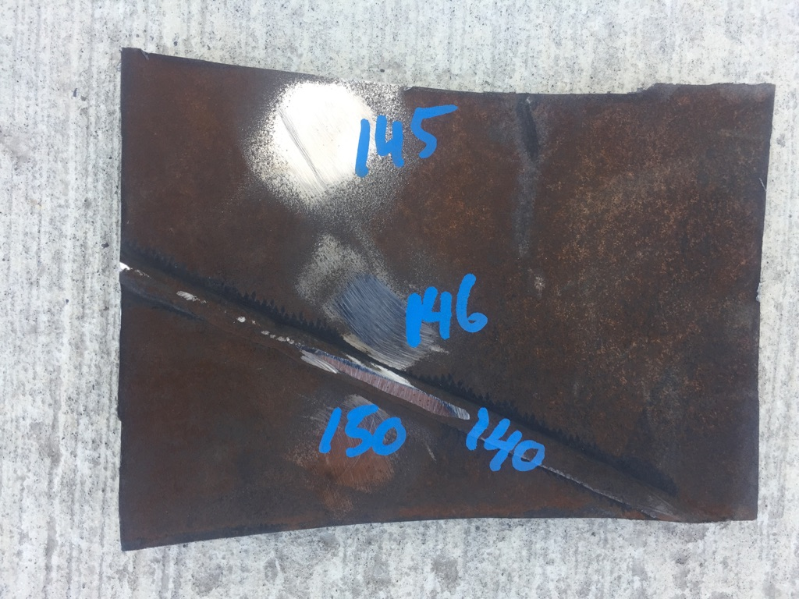
Pipe Spool Material
There was no change in hardness or dimension.

Slide 14
Cryogenic Treatment of Materials Offers Breakthrough Reductions in Corrosion

Slide 15
DCT induces microstructural and mechanical changes, which also influence the corrosion dynamics. DCT is confirmed to reduce exfoliation of the corrosion product layer due to reduced surface cracking induced by residual stress-of the microstructure.

Slide 16
Reduces corrosion in high-carbon steel by 20-60% and reduces stress corrosion cracking as a result of Hydrogen Embrittlement.

Slide 17
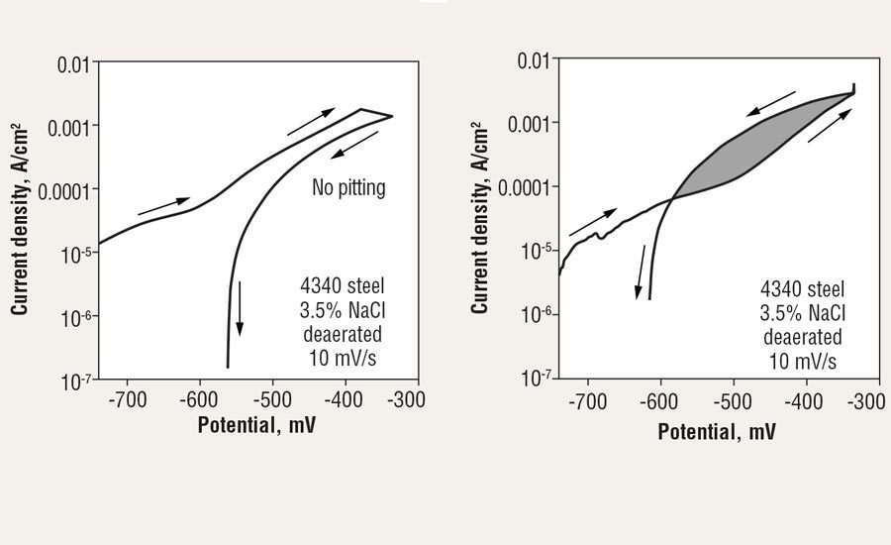
Potentiodynamic pitting-resistance test of 4340 for 36 hours in 3.5% NaCl for three cryo treated coupons (a) and three non-cryo coupons (b)

Slide 18
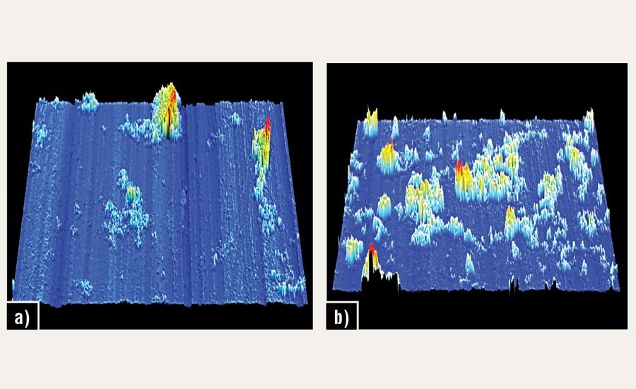
Uniform surface-corrosion test of 4340 steel. Test was 18 hours in 3.5% NaCl with a result of 64% (volumetric) reduction in corrosion with cryo (a) vs. non-cryo (b)

Slide 19
Exotic-alloy substitutions help, but the higher price and limited supply chain present barriers. Carbon steel is cheaper and widely available, the alloy is often entrained with hydrogen, which is diffused along grain boundaries that can’t meet longevity or performance requirements in some environments.
Imagine the possibilities of asset protection by cryo-treating high value assets that are manufactured with high cost alloys such as titanium. We even get great results with aluminum, different plastic compounds, polyurethanes even wood.
Imagine the possibilities of taking average and making it extraordinary.

Slide 20
In Closing, Industrial Cryogenic Processing has long been thought of as a way to enhance performance and extend the life cycle of certain materials, now it’s beyond proven. We are starting to be recognized as a great way to add value to the ever important bottom line of your company. Through these
remarkable attributes we will try and expand the way
mainstream industries look at asset protection.
This is especially true in Oil & Gas.
We will continue to
learn and explore this unique way
of reducing, resisting and preventing
corrosion within all sectors of the industry. With science and ingenuity we can help inspire todays and tomorrows engineers, towards a new way to help protect our assets.

Slide 21
INDUSTRIAL CRYOGENIC PROCESSING

